Slide 1
Capstone Project
TechDoc Documentation

Slide 2
PROJECT MANAGEMENT
By
Vennila Gunasekhar & Ritesh Biswal

Slide 3
Problem Statement
Design complete solution to demonstrate end-to-end ML pipeline development and manage a machine/ deep learning project.
Develop an understanding of all stages of a machine learning project lifecycle.
Showcase understanding of software engineering and Engineering Cloud Computing (EC2) best practices while developing the project.

Slide 4
Overview
TechDocs is a great on-line LaTeX editing tool that allows us to create LaTeX documents directly in our web browser.
This document explains how to create a new project in TechDocs, either starting from scratch, uploading your own files or using one of the many templates available.
It is available as an on-premises or a cloud-based offering.

Slide 5
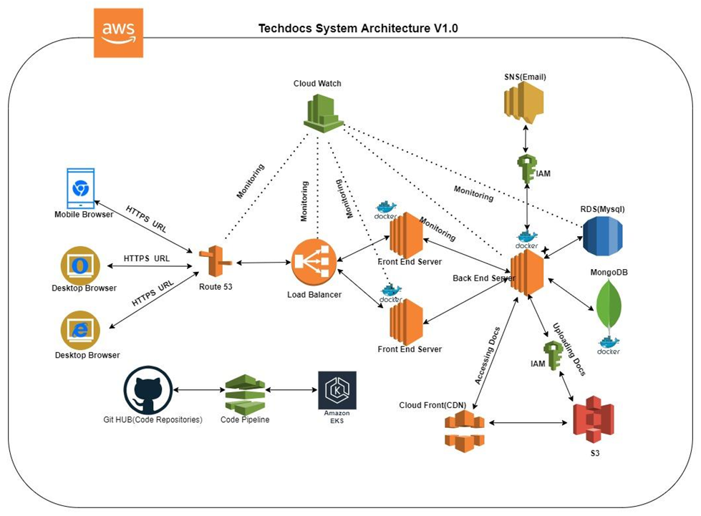

Slide 6
A Walk-Through
Utilization of Maximum AWS Services for this TechDocs Project
Cloud Watch – Used as a Monitoring Tool for Route S3, Load Balancer, Multiple Front-End Servers, Back-End Server, RDS (MySQL).
SNS (Email) – Identification of Access Management (IAM) .
Front- End Server
– Communicates with Back-End Server in both ways
- Communicates with RDS (MySQL)
- Communicates with MongoDB.
IAM – Used for uploading Documents.
Cloud Front (CDN) – for accessing documents , Communicates with Route S3.
Route S3 - communicates with Mobile Browser, Desktop Browser, through HTTPS URL.

Slide 7
Amazon Route S3 is a highly available and scalable cloud domain name system (DNS)service. Enables to customize DNS routing policies to reduce latency.
Load Balancer – communicates with Front-End Server and Route S3.
Other important Components interconnected with this project Architecture are :
- GitHub for Code Repositories.
- Code Pipeline - AWS CodePipeline is a continuous delivery service you can use to model, visualize, and automate the steps required to release your software.
- Amazon EKS – Amazon Elastic Kubernetes Service (Amazon EKS) is a managed Kubernetes service to run Kubernetes in the AWS cloud and on-premises data centers.

Slide 8
Technical documentation is any piece of writing that describes the application, purpose, creation or architecture of a product or service. Its goal is to explain something an organization offers.

Slide 9
THANK YOU

